Slide 1
Credit Risk Analysis using SQL
By Rounak Pyne

Slide 2
Synopsis
Purpose Of the Project.
Key point Explanation.
Exploring and Cleaning data.
Data analysis
Key Insights
Real Life scenario based solution.

Slide 3
Purpose of the project
The sole purpose of the project is to find the key factors mentioned to which bank loan defaulters are created.
With the given key attributes we find the percentage by which they can be defaulters.
We have multiple scenarios which explain the key factors to which a person can default and their probability of it.
We found out the total amount by percentage defaulters in the given data is 21%

Slide 4
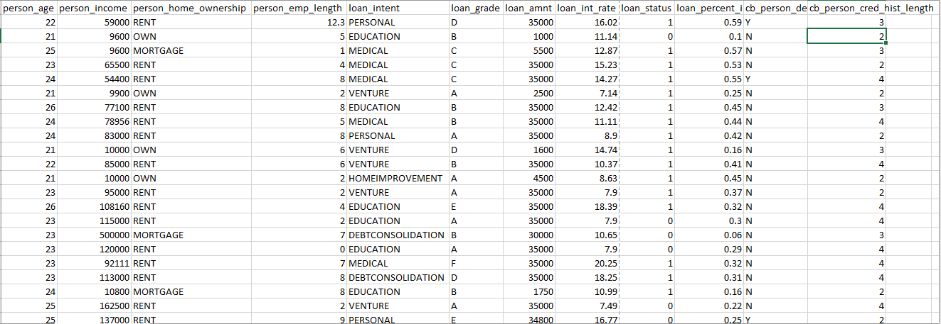
Key point Explanation.
Overview of the dataset -
We have person_age(Age) , person_income(Annual Income) , Employment length (in years) , Loan intent , Loan grade , Loan amount , Interest rate , Loan status (0 is non default 1 is default) , loan_percent_income, cb_person_default_on_file, cb_preson_cred_hist_length.

Slide 5
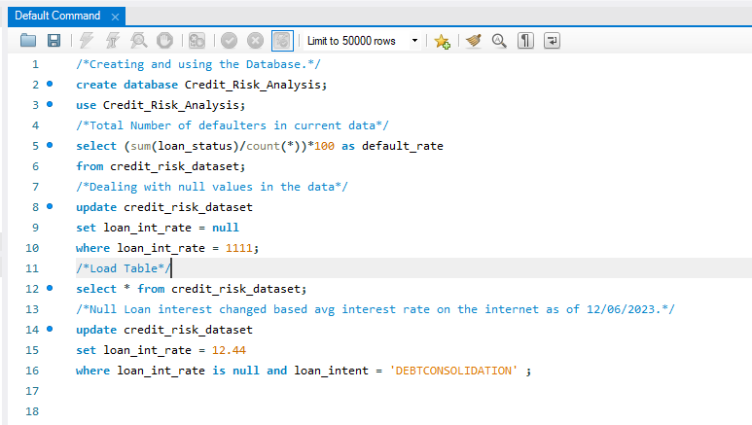
Exploring and Cleaning data.
Here We Created the Database and found the total percentage of defaulters replaced null value with valid values etc.

Slide 6
Data analysis
Planning : With the given data find the risk prone areas while subletting the data and finding the default percentage as to where the risk is higher or lower.
Analysis:
Our Target to which we base our finding is the defaulter folder where we find that cumulative total percentage of defaulters in the entire data.
Which Key factors associate with the being a defaulter or not with the subset of the data.
Using a scenario based on actual facts which comprise of the finding the percentage of if the they will default or not.

Slide 7
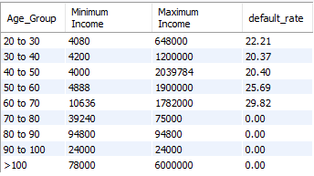
Key Insights
Which age group has the most defaulters with the minimum and maximum income
As we can see here age group of 50 to 60 and 60 to 70 given their income size have a defaulter rate of more than 25 %.

Slide 8
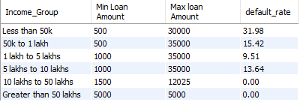
Key Insights
Which Income source has the most defaulters with minimum and the maximum loan amount.
Income group of less than 50K have taken a significant loan amount and have default rate of 32% and people with 50k to 1Lkh also have taken a amount on the higher side and are a 15.42% defaulter chance. So with income of more than 5Lkh have a lesser chance of defaulting.

Slide 9
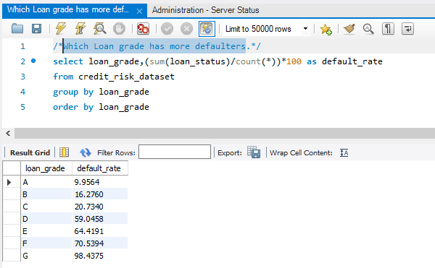
Key Insights
Which Loan grade has more defaulters
Loan grades (D,E,F and G) have significantly high risk of getting defaulted.

Slide 10
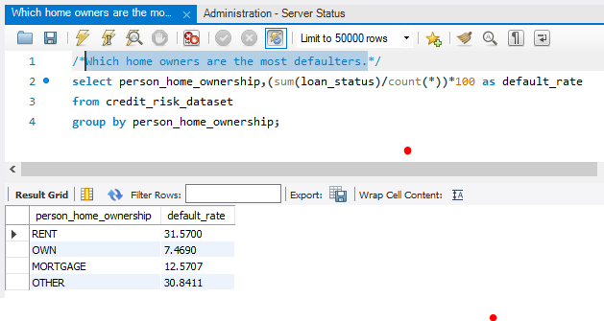
Key Insights
Which home owners are the most defaulters.
Home owners who are on rent and other have a defaulter rate of 31% and 30% which puts them at high risk individuals.

Slide 11
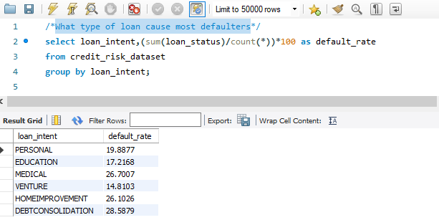
Key Insights
What type of loan cause most defaulters.
Medical at 26% , Home improvement at 26% and Debt. Consolidation at 28% are the most riskiest defaulters.

Slide 12
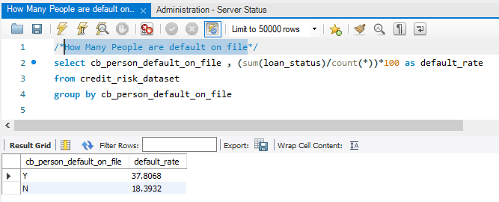
Key Insights
How Many People are default on file
People with defaulted Y on paper or file have more defaulter percentage.

Slide 13
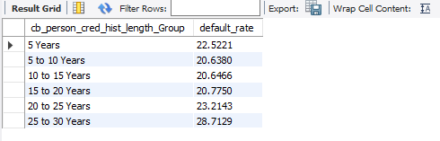
Key Insights
How Many People are default on file
People with less than 5 years and 20 to 25 Years have more than 20% risk but people with 20 to 30 years have more risk of being defaulters .

Slide 14
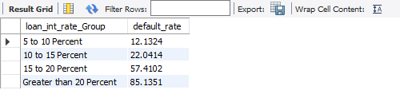
Key Insights
At Which loan Interest rate group can we see most defaulters
Interest rate of 15 to 20 percent with 57% and Greater than 20 percent with 85% are very risky are more likely to be defaulters .

Slide 15

Key Insights
At Which loan amount group can we see most defaulters
Loan amount of more than 25000 with 33% are very risky and Loan amount of 10000 to 25000 with 26% are risky and 1000 to 10K with moderate risk are more likely to be defaulters .

Slide 16
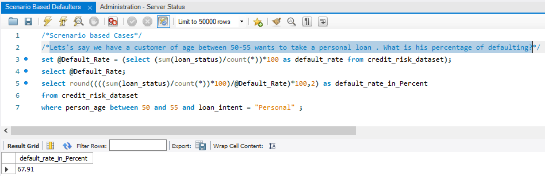
Real Life scenario based solution
Let's say we have a customer of age between 50-55 wants to take a personal loan . What is his percentage of defaulting?
On a real day with real problem we can see that a person aged between 50 and 55 wants to take a personal loan with the given historical data we can say that the person has 67.91% person risk of being a defaulter.

Slide 17
THANK YOU

